Slide 1
Course Name: Database Systems Course Code: CS52 Credits: 3:1:0 UNIT 4 Term: Oct 2021 – Feb 2022
M.S. Ramaiah Institute of Technology
(Autonomous Institute, Affiliated to VTU)
Department of Computer Science and Engineering
Faculty:
Dr. Sini Anna Alex

Slide 2
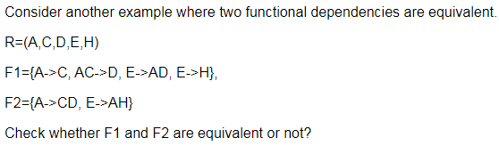
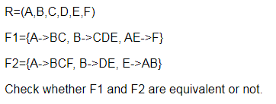
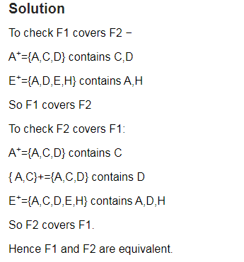
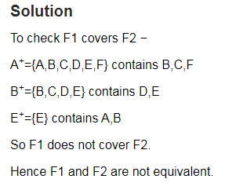
Examples:

Slide 3
Minimal Sets of FDs
A set of FDs is minimal if it satisfies the following conditions:
Every dependency in F has a single attribute for its RHS.
We cannot replace any dependency X -> A in F with a dependency Y -> A, where Y proper-subset-of X ( Y subset-of X) and still have a set of dependencies that is equivalent to F.
We cannot remove any dependency from F and have a set of dependencies that is equivalent to F.
Simple FD
Left Reduced FD
Non-redundant FD

Slide 4
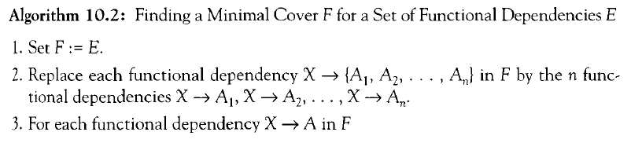
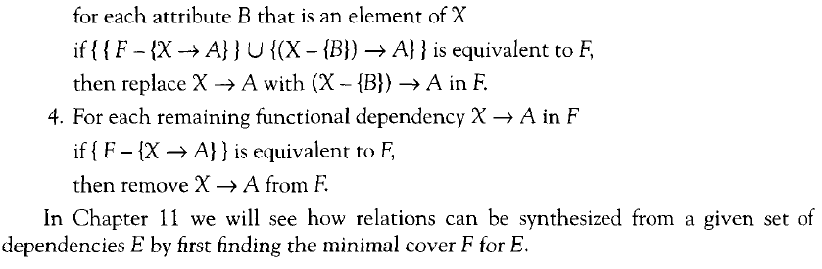
Minimal Sets of Functional Dependencies

Slide 5
Minimal Sets of FDs
Every set of FDs has an equivalent minimal set.
There can be several equivalent minimal sets.
There is no simple algorithm for computing a minimal set of FDs that is equivalent to a set F of FDs.
To synthesize a set of relations, we assume that we start with a set of dependencies that is a minimal set.
Minimal Cover: set of FD’s equivalent to given FD’s
Canonical Cover: Left side must be unique

Slide 6
Find Minimal Cover/ Canonical Cover of E
Let the given set of FDs be E : {B → A, D → A, AB → D}.We have to find the minimum cover of E.
■ All above dependencies are in canonical form; so we have completed step 1 of Algorithm 10.2 and can proceed to step 2.
In step 2 we need to determine if AB → D has any redundant attribute on the left-hand side; that is, can it be replaced by B → D or A → D?
■ Since B → A, by augmenting with B on both sides (IR2), we have BB → AB, or B → AB
(i). However, AB → D as given (ii).
■ Hence by the transitive rule (IR3), we get from (i) and (ii), B → D. Hence AB → D may be replaced by B → D.
■ We now have a set equivalent to original E , say E′ : {B → A, D → A, B → D}. No further reduction is possible in step 2 since all FDs have a single attribute on the left-hand side.
■ In step 3 we look for a redundant FD in E′. By using the transitive rule on B → D and D → A, we derive B → A. Hence B → A is redundant in E’ and can be eliminated.
■ Hence the minimum cover of E is {B → D, D → A}

Slide 7
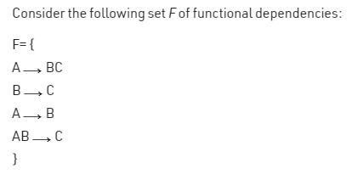
Compute the Minimal Cover

Slide 8
Definitions of Keys and Attributes Participating in Keys
A superkey of a relation schema R = {A1, A2, ...., An} is a set of attributes S subset-of R with the property that no two tuples t1 and t2 in any legal relation state r of R will have t1[S] = t2[S]
A key K is a superkey with the additional property that removal of any attribute from K will cause K not to be a superkey any more.

Slide 9
Definitions of Keys and Attributes Participating in Keys
If a relation schema has more than one key, each is called a candidate key.
One of the candidate keys is arbitrarily designated to be the primary key, and the others are called secondary keys.
A Prime attribute must be a member of some candidate key
A Nonprime attribute is not a prime attribute—that is, it is not a member of any candidate key.

Slide 10
Finding Candidate Keys and Super Keys of a Relation using FD set
The set of attributes whose attribute closure is set of all attributes of relation is called super key of relation.
Consider the following FD set. {E-ID->E-NAME, E-ID->E-CITY, E-ID->E-STATE, E-CITY->E-STATE}
Let us calculate attribute closure of different set of attributes: EMPLOYEE(E-ID, E-NAME, E-CITY, E-STATE)
(E-ID)+ = {E-ID, E-NAME,E-CITY,E-STATE}
(E-ID,E-NAME)+ = {E-ID, E-NAME,E-CITY,E-STATE}
(E-ID,E-CITY)+ = {E-ID, E-NAME,E-CITY,E-STATE}
(E-ID,E-STATE)+ = {E-ID, E-NAME,E-CITY,E-STATE}
(E-ID,E-CITY,E-STATE)+ = {E-ID, E-NAME,E-CITY,E-STATE}
(E-NAME)+ = {E-NAME}
(E-CITY)+ = {E-CITY,E-STATE}

Slide 11
First Normal Form
Disallows
composite attributes
multivalued attributes
nested relations; attributes whose values for an individual tuple are non-atomic
Considered to be part of the definition of relation

Slide 12
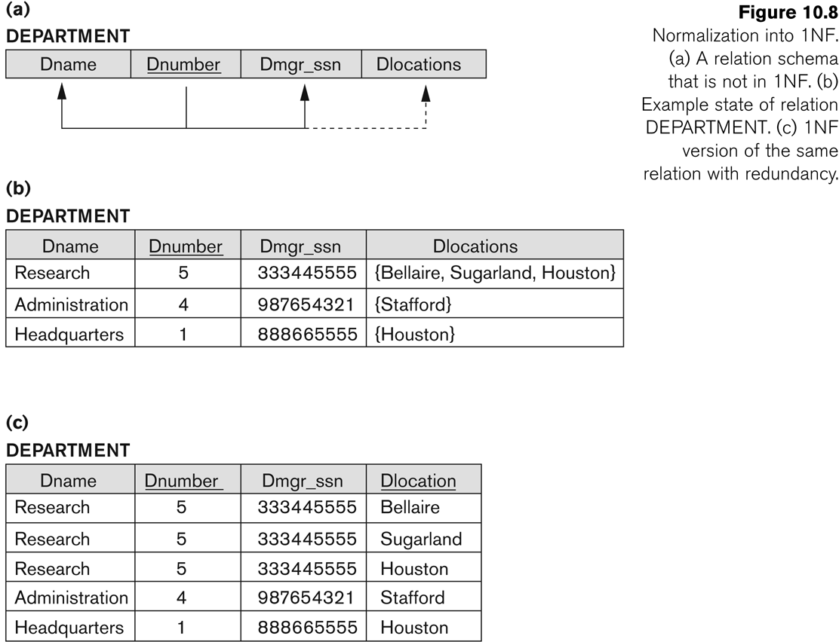
Normalization into 1NF

Slide 13
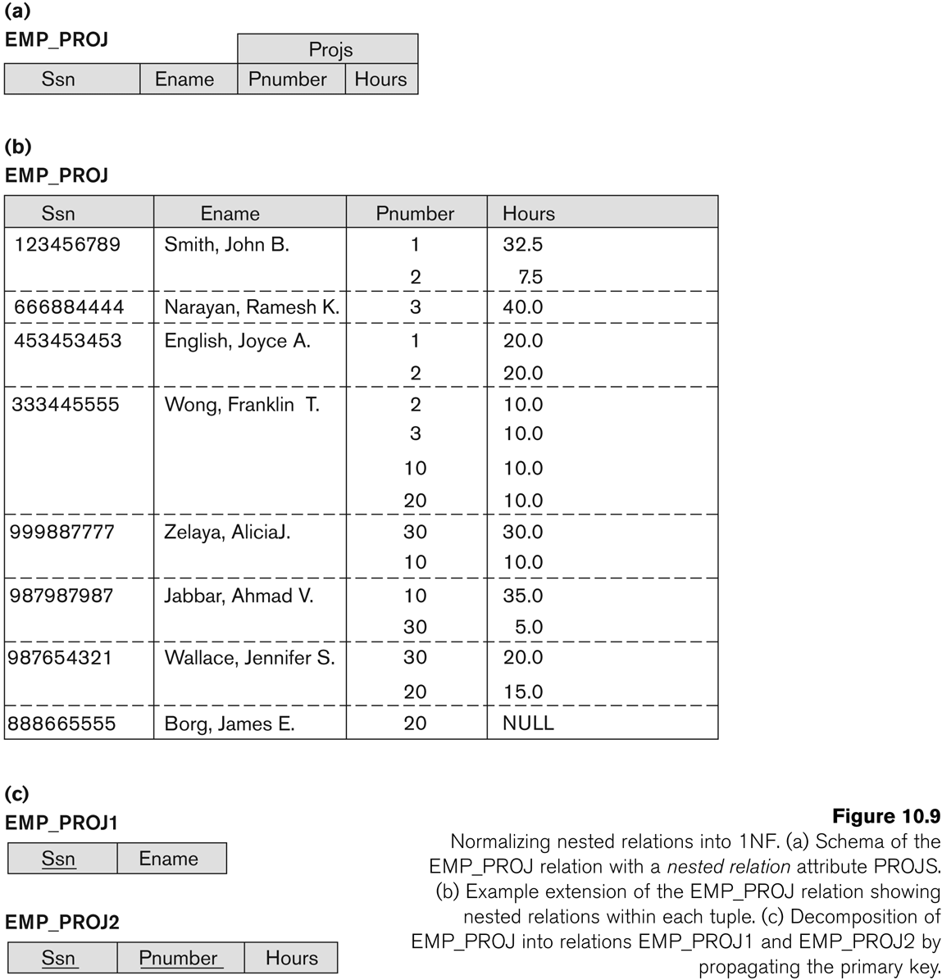
Normalization nested relations into 1NF

Slide 14
Thank you

